Slide 1
Chapter 4
Software design

Slide 2
Introduction To Software Design
Process to transform user requirements into some suitable form.
Helps the programmer in software coding and implementation.
For assessing user requirements, an SRS (software requirement specification) document is created whereas, for coding and implementation, there is a need for more specific and detailed requirements in software terms.
The output of this process can directly be used into implementation in programming languages.
Software design is the first step in SDLC (software design life cycle), which moves the concentration from the problem domain to the solution domain.
It tries to specify how to fulfill the requirements mentioned in srs.

Slide 3
Good software designs
Characteristics | Good Design | Bad Design
Change | Change is one part of the system does not always require a change in another part of the system. | One conceptual change requires changes to many parts of the system.
Logic | Every piece of logic has one and only one home. | Logic has to be duplicated.
Nature | Simple | Complex
Cost | Small | Very high
Link | The logic link can easily be found. | The logic link cannot be remembered.
Extension | System can be extended with changes in only one place. | System cannot be extended so easily.

Slide 4
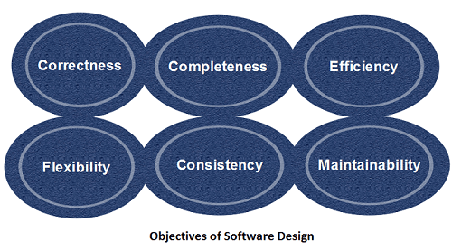
Objectives of Software Design

Slide 5
Objectives of Software Design
Correctness: Software design should be correct as per requirement.
Completeness: The design should have all components like data structures, modules, and external interfaces, etc.
Efficiency: Resources should be used efficiently by the program.
Flexibility: Able to modify to changing needs.
Consistency: There should not be any inconsistency in the design.
Maintainability: The design should be so simple so that it can be easily maintainable by other designers.

Slide 6
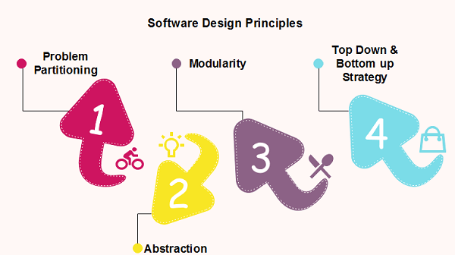
Design Principle
Providing means to handle the complexity of the design process effectively.
Effectively managing the complexity will not only reduce the effort needed for design but can also reduce the scope of introducing errors during design.

Slide 7
1. Problem Partitioning
For small problems, we can handle the entire problem at once
Benefits of Problem Partitioning
Software is easy to understand
Software becomes simple
Software is easy to test
Software is easy to modify
Software is easy to maintain
Software is easy to expand
These pieces cannot be entirely independent of each other as they together form the system.
They have to cooperate and communicate to solve the problem.
This communication adds complexity.

Slide 8
2. Abstraction
An abstraction is a tool that enables a designer to consider a component at an abstract level without bothering about the internal details of the implementation.
Abstraction can be used for existing elements as well as the component being designed.
Here, there are two common abstraction mechanisms
Functional Abstraction
Data Abstraction

Slide 9
Conti..
Functional Abstraction
A module is specified by the method it performs.
The details of the algorithm to accomplish the functions are not visible to the user of the function.
Functional abstraction forms the basis for Function oriented design approaches.
2.Data Abstraction
Details of the data elements are not visible to the users of data.
Data Abstraction forms the basis for Object Oriented design approaches.

Slide 10
4.Modularity
Modularity specifies to the division of software into separate modules which are differently named and addressed and are integrated later on in to obtain the completely functional software.
It is the only property that allows a program to be intellectually manageable.
Single large programs are difficult to understand and read due to a large number of reference variables, control paths, global variables, etc.

Slide 11
The desirable properties of a modular system are:
Each module is a well-defined system that can be used with other applications.
Each module has single specified objectives.
Modules can be separately compiled and saved in the library.
Modules should be easier to use than to build.
Modules are simpler from outside than inside.

Slide 12
Advantages of Modularity
It allows large programs to be written by several or different people
It encourages the creation of commonly used routines to be placed in the library and used by other programs.
It simplifies the overlay procedure of loading a large program into main storage.
It provides more checkpoints to measure progress.
It provides a framework for complete testing, more accessible to test
It produced the well designed and more readable program.

Slide 13
Disadvantages of Modularity
Execution time maybe, but not certainly, longer
Storage size perhaps, but is not certainly, increased
Compilation and loading time may be longer
Inter-module communication problems may be increased
More linkage required, run-time may be longer, more source lines must be written, and more documentation has to be done

Slide 14
Modular design
Modular design reduces the design complexity and results in easier and faster implementation by allowing parallel development of various parts of a system.
Different section of modular design are :-
Functional Independence
Information Hiding

Slide 15
A. Functional Independence:
Functional independence is achieved by developing functions that perform only one kind of task and do not excessively interact with other modules.
Independence is important because it makes implementation more accessible and faster.
The independent modules are easier to maintain, test, and reduce error propagation and can be reused in other programs as well.
Thus, functional independence is a good design feature that ensures software quality.
It is measured using two criteria:
Cohesion: It measures the relative function strength of a module.
Coupling: It measures the relative interdependence among modules.

Slide 16
I. Cohesion
Cohesion is a measure that defines the degree of intra-dependability within elements of a module.
The greater the cohesion, the better is the program design.
There are seven types of cohesion, namely –
Co-incidental cohesion - It is unplanned and random cohesion, which might be the result of breaking the program into smaller modules for the sake of modularization. Because it is unplanned, it may serve confusion to the programmers and is generally not-accepted.
Logical cohesion - When logically categorized elements are put together into a module, it is called logical cohesion.
Temporal Cohesion - When elements of module are organized such that they are processed at a similar point in time, it is called temporal cohesion.

Slide 17
I. Cohesion
Procedural cohesion - When elements of module are grouped together, which are executed sequentially in order to perform a task, it is called procedural cohesion.
Communicational cohesion - When elements of module are grouped together, which are executed sequentially and work on same data (information), it is called communicational cohesion.
Sequential cohesion - When elements of module are grouped because the output of one element serves as input to another and so on, it is called sequential cohesion.
Functional cohesion - It is considered to be the highest degree of cohesion, and it is highly expected. Elements of module in functional cohesion are grouped because they all contribute to a single well-defined function. It can also be reused.

Slide 18
II. Coupling
Coupling is a measure that defines the level of inter-dependability among modules of a program.
It tells at what level the modules interfere and interact with each other. The lower the coupling, the better the program.
There are five levels of coupling, namely -
Content coupling - When a module can directly access or modify or refer to the content of another module, it is called content level coupling.
Common coupling- When multiple modules have read and write access to some global data, it is called common or global coupling.

Slide 19
II. Coupling
Control coupling- Two modules are called control-coupled if one of them decides the function of the other module or changes its flow of execution.
Stamp coupling- When multiple modules share a common data structure and work on a different part of it, it is called stamp coupling.
Data coupling- Data coupling is when two modules interact with each other by means of passing data (as a parameter). If a module passes data structure as a parameter, then the receiving module should use all its components.
Ideally, no coupling is considered to be the best.

Slide 20
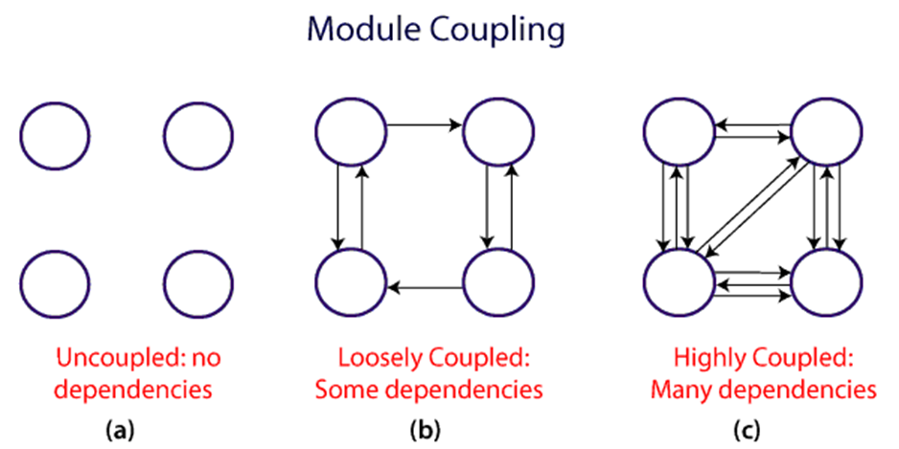
II. Coupling

Slide 21
B. Information hiding:
Modules should be specified that data include within a module is inaccessible to other modules that do not need for such information.
The use of information hiding as design criteria for modular system provides the most significant benefits when modifications are required during testing's and later during software maintenance.
This is because as most data and procedures are hidden from other parts of the software, inadvertent errors introduced during modifications are less likely to propagate to different locations within the software.

Slide 22
Software Design Strategy
A good system design strategy is to organize the program modules in such a method that are easy to develop and latter too, change.
Structured design methods help developers to deal with the size and complexity of programs.
Analysts generate instructions for the developers about how code should be composed and how pieces of code should fit together to form a program.
To design a system, there are two possible approaches:
Top-down Approach
Bottom-up Approach

Slide 23
a. Top-down Approach
Informal design strategy for breaking problem into smaller problems.
Design activity must begin with the analysis of the requirements definition and should not consider implementation details at first.
The specification is viewed as describing a black box for the program.
A software project is decomposed into subprojects and this procedure is repeated until the sub task has become so simple that an algorithm can be formulated as a solution.

Slide 24
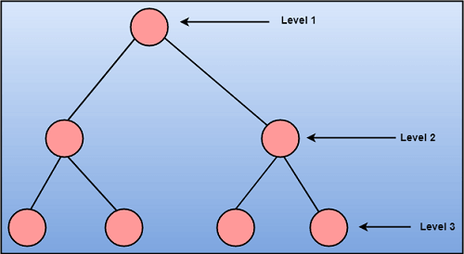
Conti..

Slide 25
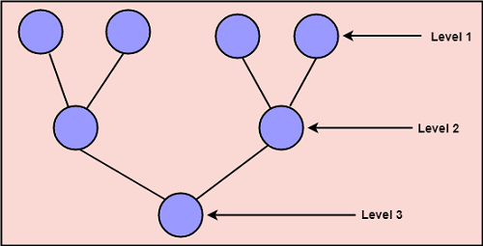
b. Bottom-up Approach:
A bottom-up approach begins with the lower details and moves towards up the hierarchy, as shown in fig.
This approach is suitable in case of an existing system.

Slide 26
Design Process
The software design process can be divided into the following three levels of phases of design:
Interface Design
Architectural Design
Detailed Design

Slide 27
Interface Design
Specification of the interaction between a system and its environment.
This phase proceeds at a high level of abstraction with respect to the inner workings of the system
During interface design, the internal of the systems are completely ignored and the system is treated as a black box.
Attention is focused on the dialogue between the target system and the users, devices, other systems with which it interacts.
The design problem statement produced during the problem analysis step should identify the people, other systems, and devices which are collectively called agents.

Slide 28
Interface design should include the following details
Precise description of events in the environment, or messages from agents to which the system must respond.
Precise description of the events or messages that the system must produce.
Specification on the data, and the formats of the data coming into and going out of the system.
Specification of the ordering and timing relationships between incoming events or messages, and outgoing events or outputs.

Slide 29
Architectural Design
Specification of the major components of a system, their responsibilities, properties, interfaces, and the relationships and interactions between them.
The overall structure of the system is chosen, but the internal details of major components are ignored.

Slide 30
Detailed Design:
Design is the specification of the internal elements of all major system components, their properties, relationships, processing, and often their algorithms and the data structures.
The detailed design may include:
Decomposition of major system components into program units.
Allocation of functional responsibilities to units.
User interfaces
Unit states and state changes
Data and control interaction between units
Data packaging and implementation, including issues of scope and visibility of program elements
Algorithms and data structures

Slide 31
Design Concepts
The software design concept simply means the idea or principle behind the design.
How you plan to solve the problem of designing software, the logic, or thinking behind how you will design software.
It allows the software engineer to create the model of the system or software or product that is to be developed or built.
The software design concept provides a supporting and essential structure or model for developing the right software.

Slide 32
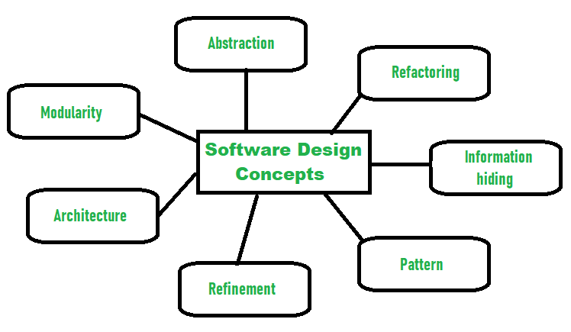
Design Concepts

Slide 33
Abstraction- hide Irrelevant data
Abstraction simply means to hide the details to reduce complexity and increases efficiency or quality.
Different levels of Abstraction are necessary and must be applied at each stage of the design process so that any error that is present can be removed to increase the efficiency of the software solution and to refine the software solution.
The solution should be described in broad ways that cover a wide range of different things at a higher level of abstraction and a more detailed description of a solution of software should be given at the lower level of abstraction.

Slide 34
Modularity- subdivide the system
Modularity simply means dividing the system or project into smaller parts to reduce the complexity of the system or project.
In the same way, modularity in design means subdividing a system into smaller parts so that these parts can be created independently and then use these parts in different systems to perform different functions.
It is necessary to divide the software into components known as modules because nowadays there are different software available like Monolithic software that is hard to grasp for software engineers.
So, modularity in design has now become a trend and is also important. If the system contains fewer components then it would mean the system is complex which requires a lot of effort (cost) but if we are able to divide the system into components then the cost would be small.

Slide 35
Architecture- design a structure
Architecture simply means a technique to design a structure of something. Architecture in designing software is a concept that focuses on various elements and the data of the structure.
These components interact with each other and use the data of the structure in architecture.

Slide 36
Refinement- removes impurities
Refinement simply means to refine something to remove any impurities if present and increase the quality.
The refinement concept of software design is actually a process of developing or presenting the software or system in a detailed manner that means to elaborate a system or software.
Refinement is very necessary to find out any error if present and then to reduce it.

Slide 37
Pattern- a repeated form
The pattern simply means a repeated form or design in which the same shape is repeated several times to form a pattern.
The pattern in the design process means the repetition of a solution to a common recurring problem within a certain context.

Slide 38
Information Hiding- hide the information
Information hiding simply means hiding the information so that it cannot be accessed by an unwanted party.
In software design, information hiding is achieved by designing the modules in a manner that the information gathered or contained in one module is hidden and can’t be accessed by any other modules.

Slide 39
Refactoring- reconstruct something
Refactoring simply means reconstructing something in such a way that it does not affect the behavior of any other features.
Refactoring in software design means reconstructing the design to reduce complexity and simplify it without affecting the behavior or its functions.

Slide 40
Design Quality
A quality product does precisely what the users want it to do.
For software products, the fitness of use is generally explained in terms of satisfaction of the requirements laid down in the SRS document.
Although "fitness of purpose" is a satisfactory interpretation of quality for many devices such as a car, a table fan, a grinding machine, etc.
For software products, "fitness of purpose" is not a wholly satisfactory definition of quality.
Example: Consider a functionally correct software product. That is, it performs all tasks as specified in the SRS document. But, has an almost unusable user interface. Even though it may be functionally right, we cannot consider it to be a quality product.

Slide 41
Software Architecture And Its Types
Software architecture is the blueprint of building software.
It shows the overall structure of the software, the collection of components in it, and how they interact with one another while hiding the implementation.
This helps the software development team to clearly communicate how the software is going to be built as per the requirements of customers.

Slide 42
Different Software Architecture Patterns :
Layered Pattern
Client-Server Pattern
Repository Architecture

Slide 43
1. Layered Pattern :
As the name suggests, components(code) in this pattern are separated into layers of subtasks and they are arranged one above another.
Each layer has unique tasks to do and all the layers are independent of one another.
One can modify the code inside a layer without affecting others.
Commonly used pattern for designing the majority of software.
This layer is also known as ‘N-tier architecture’.
Basically, this pattern has 4 layers.

Slide 44
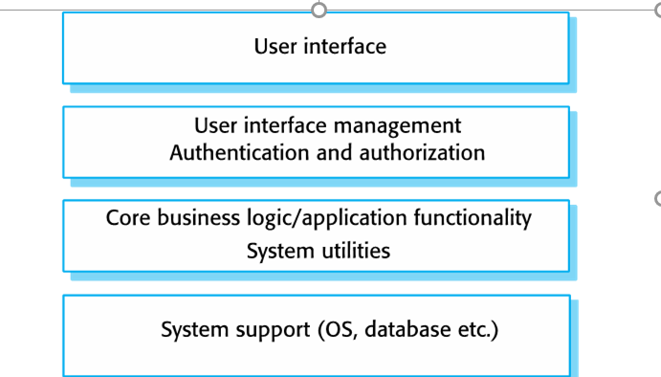
1. Layered Pattern

Slide 45
1. Layered Pattern :
Presentation layer (The user interface layer where we see and enter data into an application.)
Business layer (this layer is responsible for executing business logic as per the request.)
Application layer (this layer acts as a medium for communication between the ‘presentation layer’ and ‘data layer’.
Data layer (this layer has a database for managing data.)
Ideal for:
E-commerce web applications development like Amazon.

Slide 46
2. Client-Server Pattern
Client-server pattern has two major entities.
There are a server and multiple clients.
Here the server has resources(data, files or services) and a client requests the server for a particular resource.
Then the server processes the request and responds back accordingly.
Examples of software developed in this pattern:
Email.
WWW.
File sharing apps.
Banking, etc…
So this pattern is suitable for developing the kind of software listed in the examples.

Slide 47
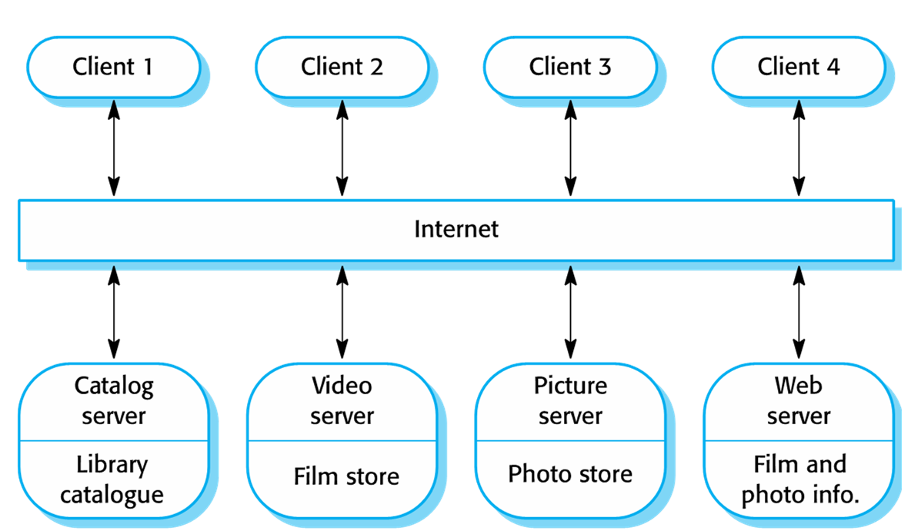
2. Client-Server Pattern

Slide 48
3. Repository Architecture
• Data is stored in a central shared repository.
• Components interact through the repository only.
• Suited to applications whose data is generated by one component and used by another.
Advantages: - Components are independent/separate. - Changes to data are automatically available to other components.
• Communication between components may be inefficient

Slide 49
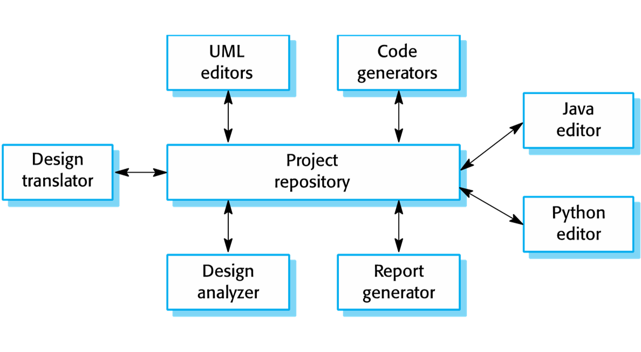
3. Repository Architecture

Slide 50
4.Model-View-Controller (MVC)
The Model-View-Controller (MVC) is an architectural pattern that separates an application into three main logical components: the model, the view, and the controller.
Each of these components are built to handle specific development aspects of an application.
MVC is one of the most frequently used industry-standard web development framework to create scalable and extensible projects.

Slide 51
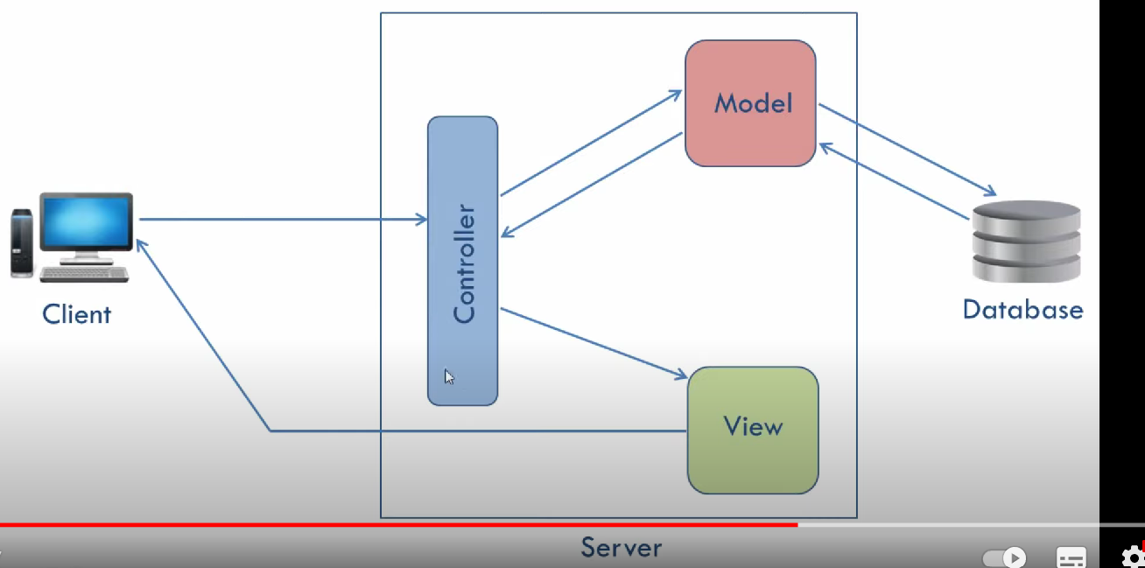
Model-View-Controller (MVC)

Slide 52
Model
The Model component corresponds to all the data-related logic that the user works with.
This can represent either the data that is being transferred between the View and Controller components or any other business logic-related data.
For example, a Customer object will retrieve the customer information from the database, manipulate it and update it data back to the database or use it to render data.

Slide 53
View
The View component is used for all the UI logic of the application.
For example, the Customer view will include all the UI components such as text boxes, dropdowns, etc. that the final user interacts with.

Slide 54
Controller
Controllers act as an interface between Model and View components to process all the business logic and incoming requests, manipulate data using the Model component and interact with the Views to render the final output.
For example, the Customer controller will handle all the interactions and inputs from the Customer View and update the database using the Customer Model.
The same controller will be used to view the Customer data.

Slide 55
Pipe and Filter architectures
Pipe and Filter is a simple architectural style that connects a number of components that process a stream of data.
Each is connected to the next component in the processing pipeline via a Pipe.
The Pipe and Filter architecture is inspired by the Unix technique of connecting the output of an application to the input of another via pipes on the shell.
The pipe and filter architecture consists of one or more data sources.
The data source is connected to data filters via pipes.
Filters process the data they receive, passing them to other filters in the pipeline.
The final data is received at a Data Sink:

Slide 56
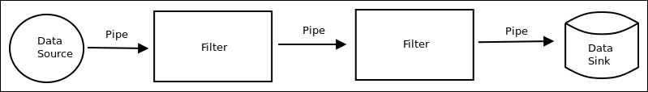
Pipe and Filter architectures

Slide 57
Application Architecture
An application architecture describes the patterns and techniques used to design and build an application.
The architecture gives you a roadmap and best practices to follow when building an application, so that you end up with a well-structured app.
Patterns can be linked together to create more generic application architectures.
Instead of completely creating the architecture yourself, you can use existing design patterns.

Slide 58
Application Architecture
As part of an application architecture, there will be both front-end and back-end services.
Front-end development is concerned with the user experience of the app, while back-end development focuses on providing access to the data, services, and other existing systems that make the app work.
The architecture is a starting point or roadmap for building an application, but you’ll need to make implementation choices not captured in an architecture.
For example, a first step is to choose a programming language in which to write the application.
There are many programming languages used for software development. Certain languages may be used to build certain types of applications, such as Swift for mobile apps or JavaScript for front-end development.

Slide 59
User Interface Design
Design of the interface or system which is directly accessible by the user and they interact with in order to do a task.
It establishes the way with which the user will interact with the product.
Its main aim is to enhance the appearance of the product, the quality of technology used and the usability of the product.
It refers to the software or the hardware of the system which the user can see and also the various ways or commands to control or use the product.
It focuses on the looks or how the app or software is looking. Attributes like theme, animations, colors, etc constitute the user interface.

Slide 60
Principles of User Interface Design
Minimize actions − Minimize action means steps per screen. The tasks and actions are streamlined so that they can be done in as few steps as possible. The interface should be designed keeping in mind to maintain the steps as few as possible for performing any tasks.
Simplicity − The user interface should not be complex. It should always be designed simple and elegant.
Consistent − The user interface should be consistent. The design should be consistent. Increasing consistency increases the familiarity, and hence increases the usability.
Proving useful feedback − The user should be provided with feedback for every action. This keeps the user informed and helps them to know whether some action was successful or not.
Clarity − Content should provide the user with clarity. There should not be anything which confuses the user, as it becomes an obstacle for the user in interacting with the product.

Slide 61
Human-Computer interaction
Cross-disciplinary area that deals with the theory design, implementation, and evaluation of the ways humans use and interact with computing devices.
User interaction means issuing commands and associated data to the computer system.
Designer focuses on how the information from the user be provided to the computer system and how can information from the computer system is presented to users.

Slide 62
Five basic method of user interactions
Direct Manipulation
Menu selection
Form fill-in
Command language
Natural Language

Slide 63
Information Presentation
Information presentation is concerned with presenting system information to system users
The information may be presented directly (e.g. text in a word processor) or may be transformed in some way for presentation (e.g. in some graphical form)
The Model-View-Controller approach is a way of supporting multiple presentations of data

Slide 64
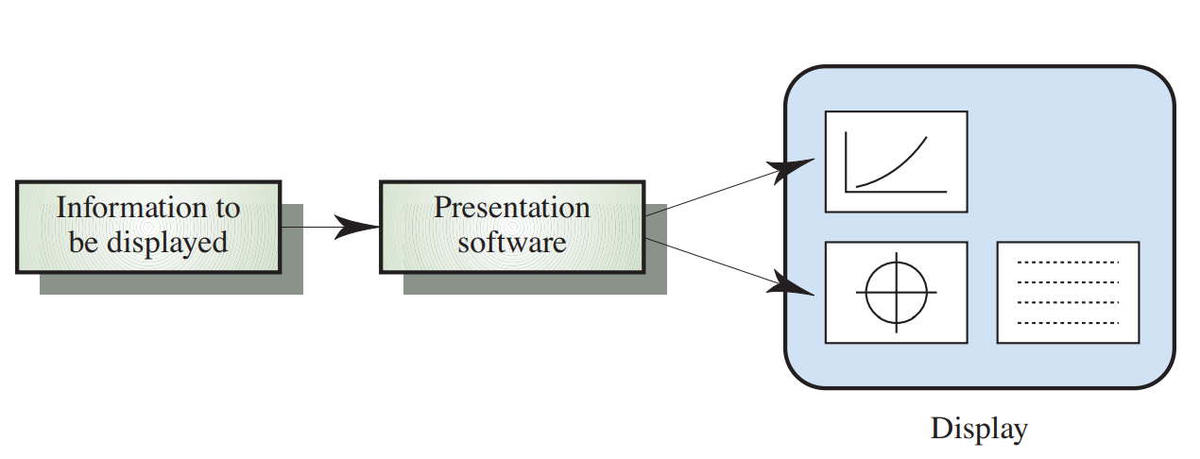
Information Presentation

Slide 65
Interface evaluation
Interface evaluation in software engineering is the process of assessing the effectiveness of the user interface (UI) design of a software application. The objective of interface evaluation is to determine whether the UI design meets the needs of the users and provides a positive user experience.
There are various techniques that can be used to evaluate the interface of a software application. Some common techniques include:
Heuristic evaluation: This technique involves a group of evaluators examining the interface of the software application and identifying potential usability issues based on a set of heuristics or guidelines.
Usability testing: This technique involves observing users as they interact with the software application and collecting data on their interactions and feedback. This can be done in a controlled lab setting or in the user's natural environment.

Slide 66
Conti..
Cognitive walkthrough: This technique involves a step-by-step analysis of how a user would complete specific tasks using the software application. This helps identify potential usability issues and areas for improvement.
A/B testing: This technique involves comparing two different interface designs and collecting data on user behavior to determine which design is more effective.
Surveys and questionnaires: This technique involves collecting feedback from users through surveys or questionnaires to assess their satisfaction with the interface design and identify areas for improvement.
Overall, interface evaluation is an important aspect of software engineering as it helps ensure that software applications are user-friendly and meet the needs of their intended audience.

Slide 67
Design Notation
Design notation in software engineering is a standardized visual language used to represent and communicate the design of a software system. Design notations are used to describe the structure, behavior, and relationships between components of a software system.
Some common design notations in software engineering include:
Unified Modeling Language (UML): UML is a standardized visual language used to represent the design of a software system. It includes a set of diagrams, such as class diagrams, sequence diagrams, and activity diagrams, which can be used to represent the various aspects of a software system.
Data Flow Diagrams (DFD): DFD is a diagrammatic representation of the flow of data within a software system. It shows how data is input, processed, and output from a system.

Slide 68
Conti..
Entity Relationship Diagrams (ERD): ERD is a diagrammatic representation of the relationships between different entities within a software system. It is commonly used to design relational databases.
State Transition Diagrams: State Transition Diagrams are used to represent the states and transitions of an object in a software system. It is commonly used to model the behavior of a system.
Flowcharts: Flowcharts are a graphical representation of the flow of control in a software system. It shows the steps involved in a process and the decision points that determine the flow of control.

